Slide 1

Intelligent Fire Detection, Smoke Monitoring & Emergency Warning System
An IoT-based solution for continuous fire hazard monitoring, real-time detection, and automated emergency alerts across residential, commercial, and industrial environments.
Early Detection
Real-Time Alerts
Identify fire hazards before they escalate
Instant notifications to users and responders
Rapid Response
Reduce property damage and protect lives
PATNALA VENKATA SATISH
323129520106

Slide 2

Problem Statement
Fire accidents cause severe loss of life and property when not detected at an early stage. Existing systems fall short in critical ways:
Local Alerts Only
Conventional fire alarm systems typically provide only on-site audible alerts, with no remote notification capability.
No Remote Monitoring
Traditional systems lack the ability to monitor conditions remotely, leaving gaps in coverage and awareness.
Delayed Detection
Limited monitoring leads to delayed emergency response, increasing the risk of casualties and property damage.
Intelligent Systems Needed
Organizations and homeowners require systems that continuously monitor fire hazards and provide immediate warning notifications.

Slide 3


Proposed Solution
IoT-Based Intelligent Fire Detection System
The proposed system leverages IoT technology to enable continuous environmental monitoring and real-time hazard detection. Key capabilities include:
Continuous detection of fire-related hazards with real-time emergency alerts
A centralized platform for monitoring all fire safety data
Secure and user-friendly interface for operators and administrators
Automated alerts delivered to users and emergency responders when abnormal conditions are detected
The system bridges the gap between detection and response — ensuring no fire hazard goes unnoticed.

Slide 4
Sensors and System Components
The system integrates multiple hardware and software components working together to deliver comprehensive fire safety coverage.
Flame Sensors
Smoke Sensors
Detect the presence of open flames in the monitored environment.
Identify abnormal smoke concentrations indicating potential fire hazards.
Temperature Sensors
IoT Communication Modules
Monitor heat levels and detect sudden temperature changes.
Transmit sensor data reliably to the central monitoring platform.
Cloud Connectivity
Local Alarm System
Enables centralized, remote monitoring of all fire safety information.
Provides immediate on-site warning upon hazard detection.

Slide 5

System Working Process
The system follows a structured end-to-end workflow — from continuous sensing to emergency response and data recording.
Sense
Collect
Transmit
Cloud Ingest
Analyze
This automated pipeline ensures that from the moment a sensor detects an anomaly, the system responds within seconds — activating local alarms, notifying users, and alerting emergency responders simultaneously.

Slide 6
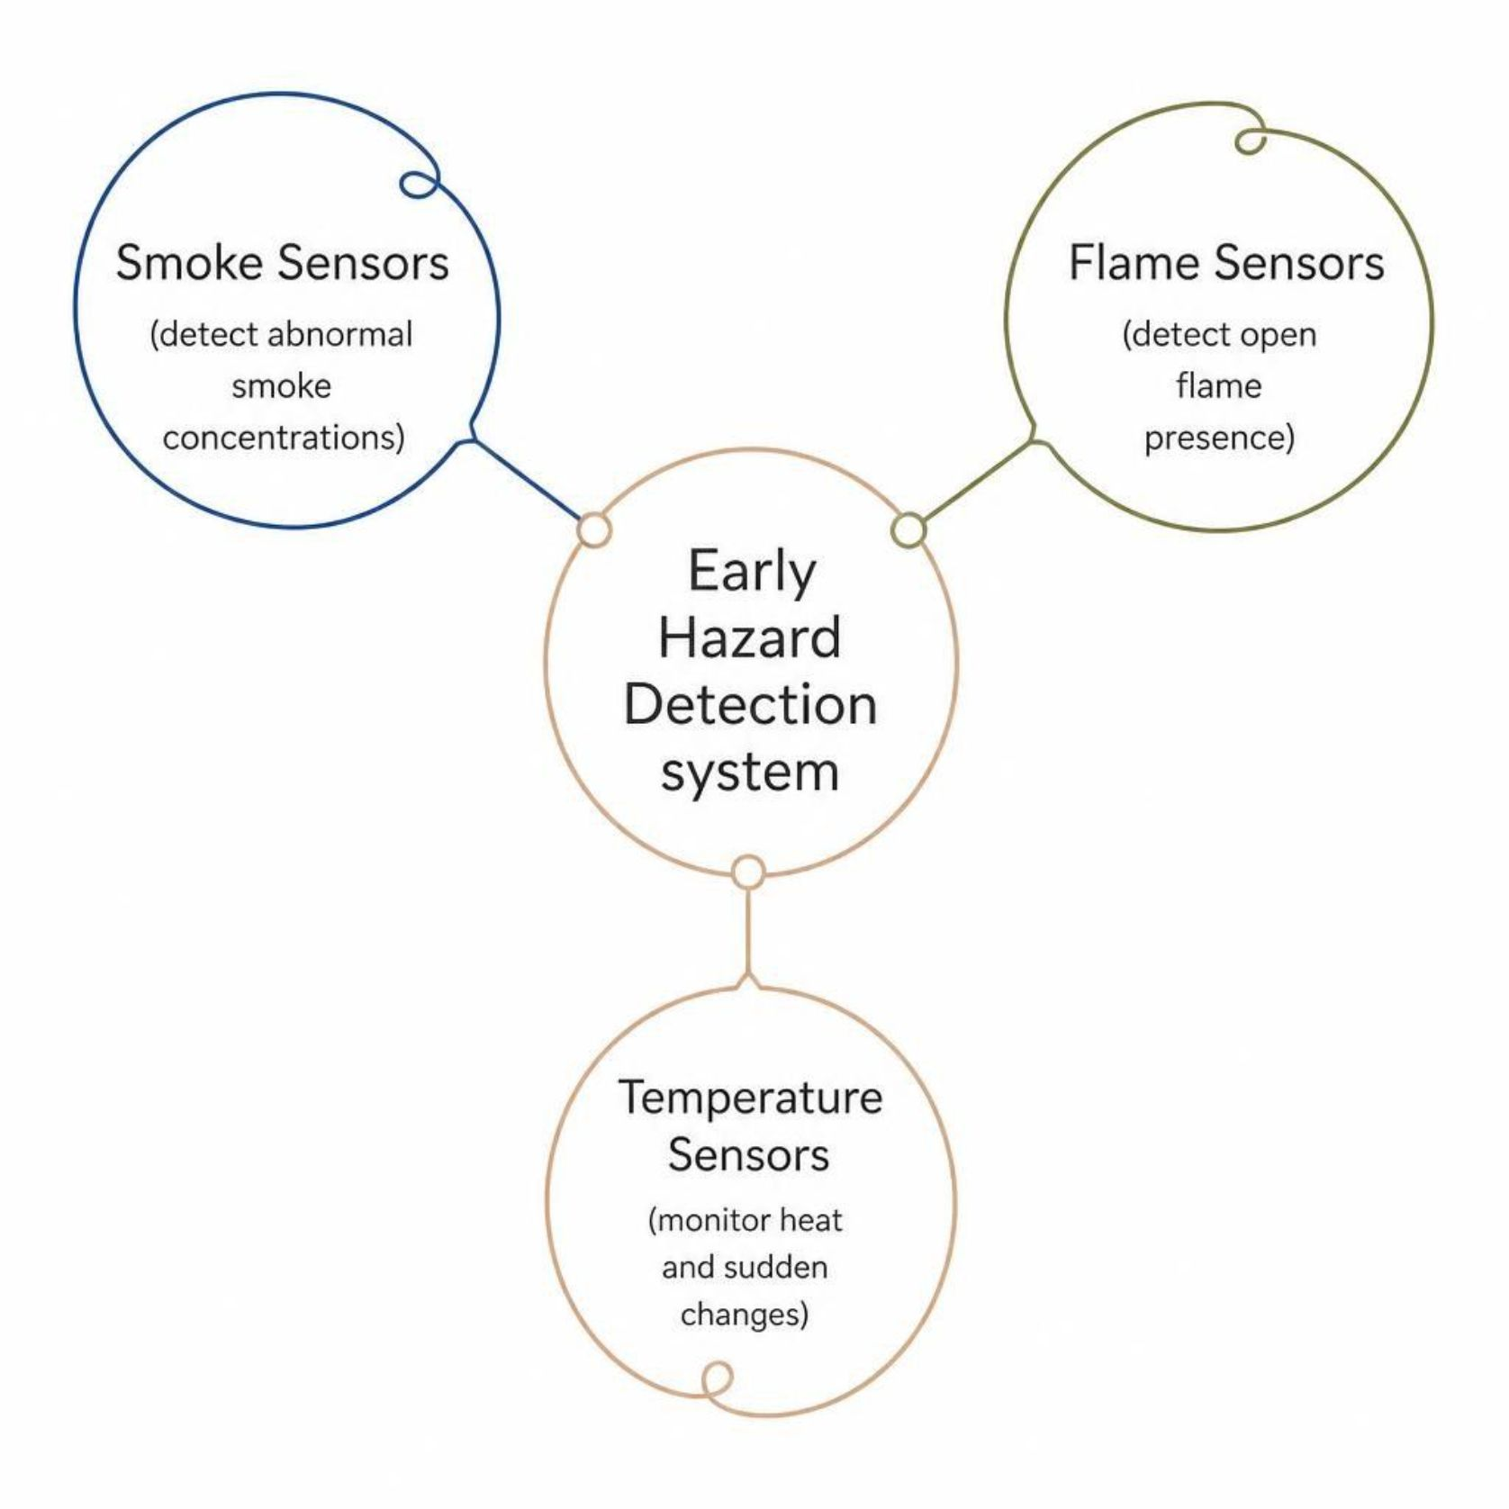

Fire and Smoke Detection
Multi-Sensor Detection Approach
Combining multiple environmental sensors significantly improves the ability to identify potential fire hazards at an early stage. The system monitors:
Continuous smoke concentration monitoring
Flame presence detection
Temperature and heat level monitoring
Identification of abnormal environmental conditions
Early detection of fire-related hazards
Real-time sensor status monitoring
Multi-sensor fusion reduces false alarms and increases detection reliability across diverse environments.

Slide 7





Emergency Alerts and Response
When abnormal conditions are detected, the system triggers a coordinated, multi-channel emergency response automatically.
Detection
Real-time identification of abnormal smoke, heat, or flame conditions
Local Alarm
Automatic activation of on-site alarms for immediate awareness
User Notification
Immediate warning notifications sent to building occupants and owners
Responder Alert
Automated alerts dispatched to emergency responders for rapid deployment

Slide 8

Monitoring Dashboard and System Health
Centralized Interactive Dashboard
The dashboard provides operators with a comprehensive, real-time view of the entire fire safety system — accessible remotely from any authorized device.
Sensor Status
Fire Alerts
Environmental Conditions
Event History
Live status of all connected sensors
Active and historical alert log
Real-time smoke, heat, and flame readings
Full record of past fire-related events
System Health
Connectivity and component diagnostics

Slide 9
Benefits and Applications
Major Benefits
Suitable Application Areas
Improved early fire detection — identify hazards before they escalate
Faster emergency response — automated alerts minimize reaction time
Homes
Industries
Remote monitoring — continuous oversight from any location
Reduced property damage — early warnings limit fire spread
Offices
Schools
Secure and scalable — reliable operation across diverse environments
Hospitals
Warehouses
Public Buildings

Slide 10

Conclusion
The proposed IoT-based Intelligent Fire Detection, Smoke Monitoring, and Emergency Warning System represents a modern, intelligent approach to fire safety — combining continuous sensing, real-time analysis, and automated emergency response in a single integrated platform.
Continuous Multi-Sensor Monitoring
Flame, smoke, and temperature sensors work together to provide uninterrupted environmental surveillance.
Integrated Emergency Response
Local alarms, remote notifications, and automated responder alerts ensure no hazard goes unaddressed.
Improved Public Safety
Early detection, rapid response, and reduced property damage make communities safer and more resilient.

